Slide 1
CTE – Fact or Fiction
Steve Stedman
Debunking common myths about
Common Table Expressions

Slide 2
1. CTE Executions
As a named result set, the CTE is only run once even if it is referenced multiple times in a query.
True or False?
FALSE The CTE is executed once for EACH time that it is referenced in a query.

Slide 3
2. CTEs are proprietary
CTEs are proprietary to Microsoft SQL Server.
True or False?
FALSE Common Table Expressions are supported by several major database platforms, among them PostgreSQL, DB2, Oracle and SQL Server, defined in SQL-99 spec

Slide 4
3. INSERT
The INERT statement can be used to INSERT rows into a CTE.
True or False?
TRUE Inserting rows into a CTE will insert those rows into the base table as long as only a single table is referenced in the CTE.

Slide 5
4. Database Versions
SQL Server only supports CTE’s on SQL Server Enterprise Edition 2008R2 and newer.
True or False?
FALSE Common Table Expressions have been supported since SQL Server 2005 and are available in all versions including SQL Azure.

Slide 6
5. Anchor Query
The anchor query is the part of the recursive CTE that stops the recursion.
True or False?
FALSE The anchor query is the part of the CTE query that is used to start recursion. The recursion stops when the recursive query produces no more results.

Slide 7
6. Stored Procedures and Functions
CTEs can be defined in user-defined routines, such as functions, stored procedures, triggers, or views.
True or False?
TRUE Common Table Expressions can be defined and used inside of stored procedures, functions, triggers and views.

Slide 8
7. CTEs and Nesting
CTEs can be nested and one CTE can reference an earlier CTE.
True or False?
TRUE Common Table Expressions can be nested. Just define multiple CTE’s and reference an earlier CTE from a later one.

Slide 9
8. Indexing CTEs
Indexes can be added to CTEs to boost performance.
True or False?
FALSE A Common Table Expression is a temporary, "inline" view - you cannot add an index to a CTE.

Slide 10
9. VIEW vs CTE
Which performs better, a non-recursive CTE or a VIEW?
They are the same.
The big gain is the recursive CTE, which you can’t achieve with a view.

Slide 11
10. CTE’s and Data Paging
CTE’s are a great way to do Data Paging for a result grid.
True or False
It Depends…...
SQL Server 2012 has the new OFFSET and FETCH clause on select statements, which is easier than CTE’s. For 2005, 2008 and 2008R2 the CTE is the best option.

Slide 12
11. CTE’s performance
Recursive CTE’s perform the same as other pseudo recursive solutions?
True or False
FALSE…...

Slide 13
12. CTE’s and TempDB
CTE’s are similar to Temp Tables or Table Variables in their use of TempDB?
True or False
FALSE Temp Tables and Table Variables both use TempDB, CTE’s do not…...
See my blog posting for all the details on this one.
http://stevestedman.com/?p=2053
It is more than we have time to prove today.

Slide 14
13. Data Paging
An alternative to a CTE would be to use the ROW_NUMBER function in the WHERE clause to filter the results.
True or False?
FALSE ROW_NUMBER can be used to get the current row number in the result set, but it is a windowing function, and windowing functions are not allowed to be used in the WHERE clause.

Slide 15
14. UPDATES
You can run an UPDATE statement against a CTE.
True or False?
It Depends…...
If the update statement only changes columns from a single table, you can do the update. If columns from multiple tables are referenced it will fail.

Slide 16
15. CTE and Hierarchical Queries
CTEs are a great way to create recursive hierarchical queries.
True or False?
TRUE Recursive hierarchical queries are easy to write with a CTE. CTE’s save time, are easy to follow, and work great for hierarchical data.

Slide 17
More Information
Follow me on Twitter
@SqlEmt
Database Health Project
http://DatabaseHealth.SteveStedman.com
Visit my website
http://stevestedman.com/
Send me an email:
Steve@SteveStedman.com
Download Slides and Sample TSQL
http://stevestedman.com/speaking/

Slide 18
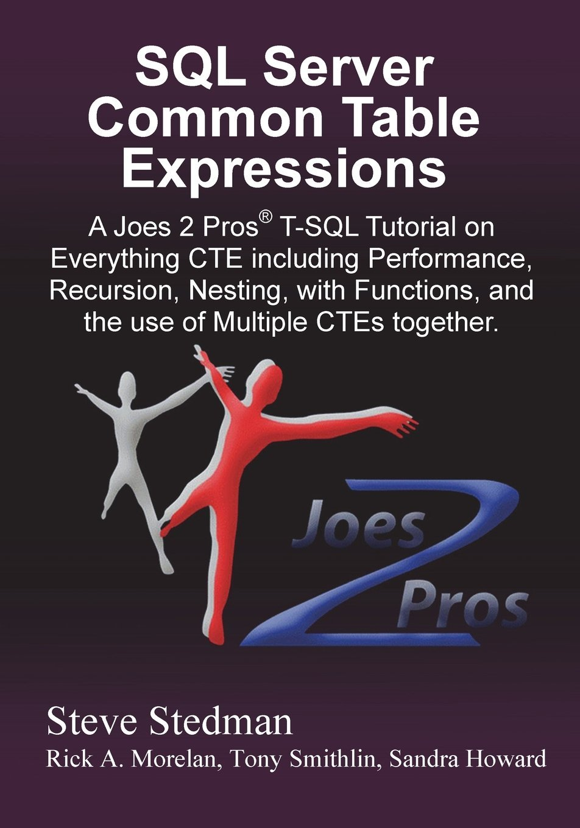
Common Table Expressions Book
Published May 2013
Available at Amazon.com and at Joes2Pros.com
Paperback and Kindle available

